Slide 1

Perceptron
Presented by : Muhammad zaqeem

Slide 2

Overview
Challenges in Machine Learning
Perceptron
How its Works
Problems in Perceptron
Multi-Layer Perceptron

Slide 3


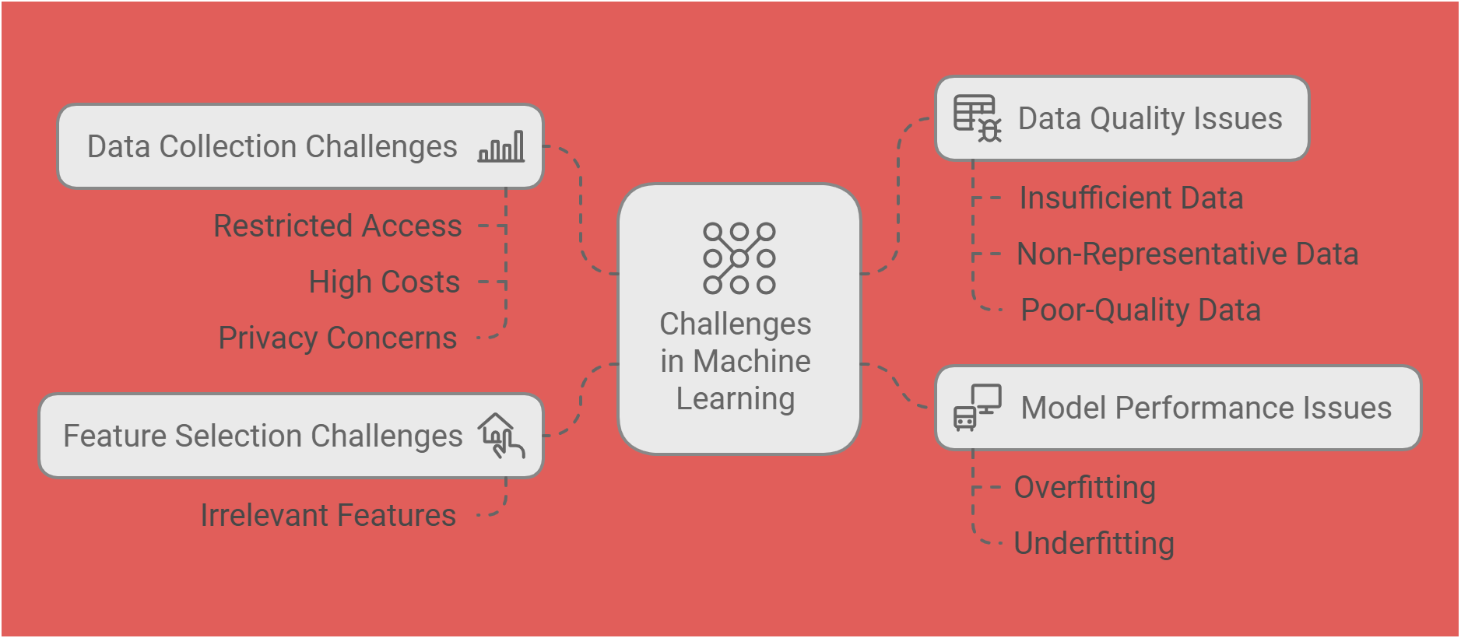

Slide 4

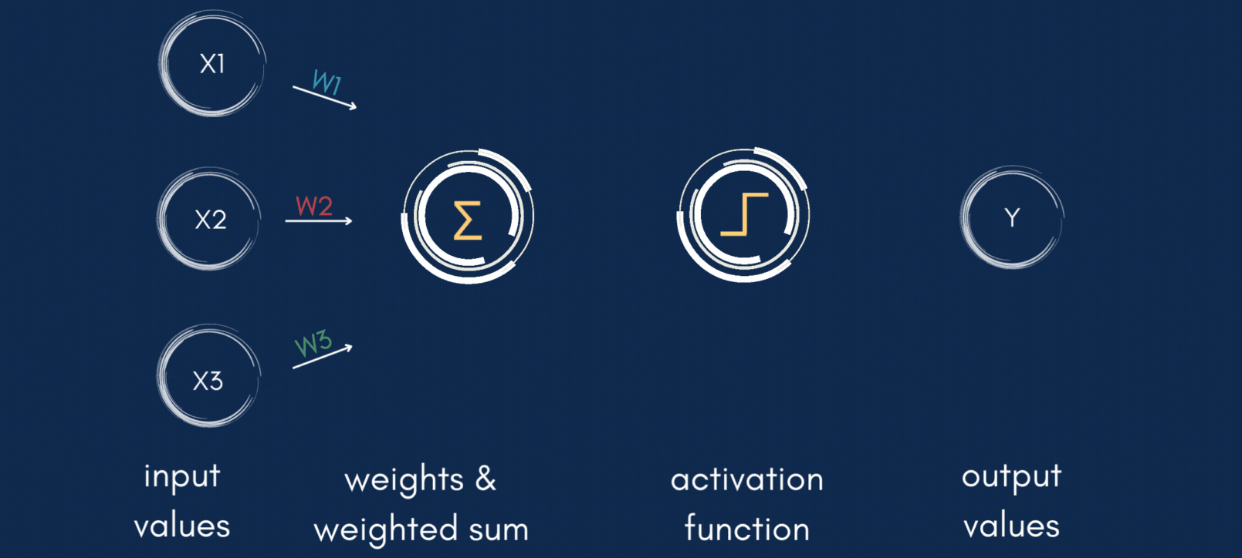
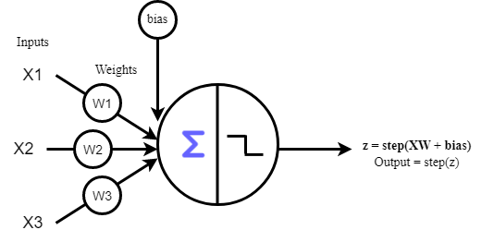
Perceptron
A perceptron is the earliest form of a neural network unit, introduced by Frank Rosenblatt in 1958.
It is a binary classifier that makes predictions based on a linear combination of input features.
A single-layer perceptron can only classify linearly separable data. It mean that can be separated by straight line

Slide 5

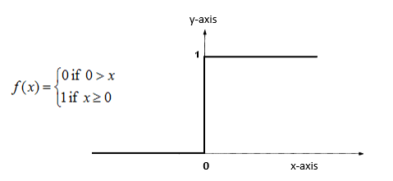
How Perceptron Works:
Inputs and Weights: The perceptron takes inputs (features) like x1, x2 and assigns weights to each input (like w1, w2).
Weighted Sum: it calculates the weighted sum of all the inputs:
z= x1*w1 + x2*w2 +…wn*xn+b
Activation Function This z is passed through an activation function (usually a step function) that either 0 or 1

Slide 6
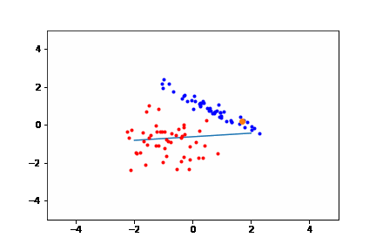
Error Calculation: After the perceptron makes a prediction, we need to calculate the error between the predicted output and the actual target.
Learning Rule: Once the error is computed, the weights and bias are updated based on the error. The goal is to reduce this error over time through adjustments to the weights and bias. The update rule for the weights and bias is:
w1​←w1​+η⋅(y−y^​)⋅x1​ , b←b+η⋅(y−y^​)
w2​←w2​+η⋅(y−y^​)⋅x2​

Slide 7

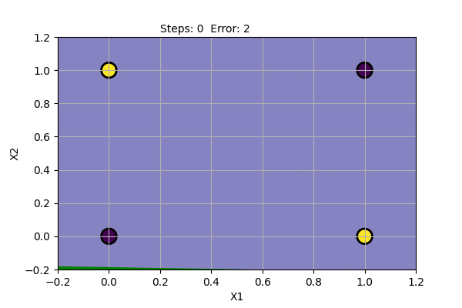
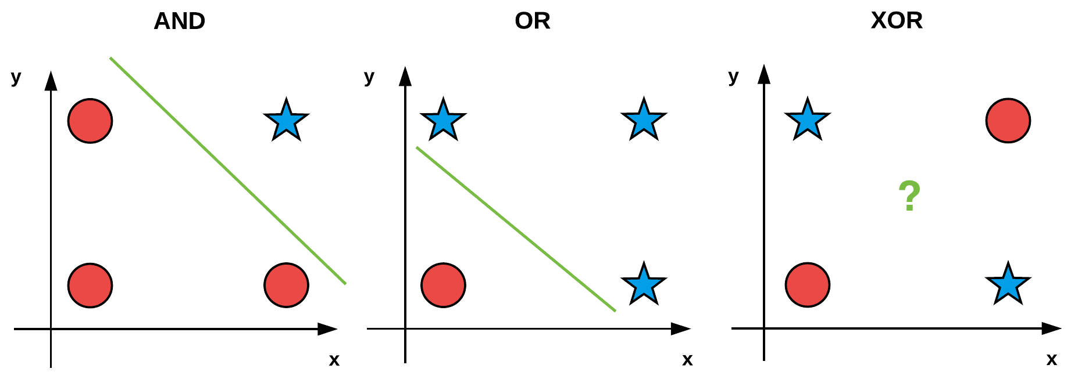
Problem in Perceptron
No Backpropagation: The perceptron algorithm does not use the backpropagation algorithm to adjust weights. Instead, it relies on a simple perceptron update rule, which modifies the weights only when the perceptron makes a mistake in classification.
Can’t Handle Non Linear Data: It fails on nonlinearly separable problems like the XOR problem.

Slide 8
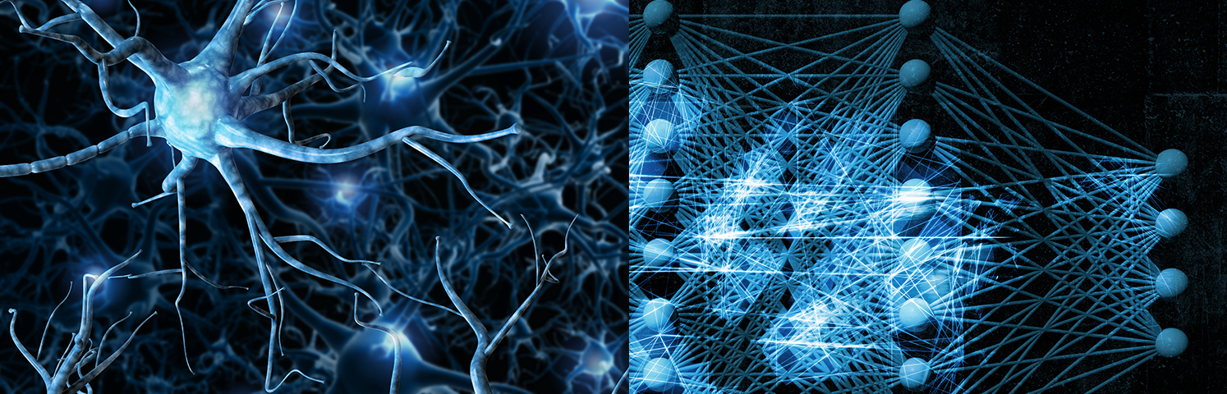
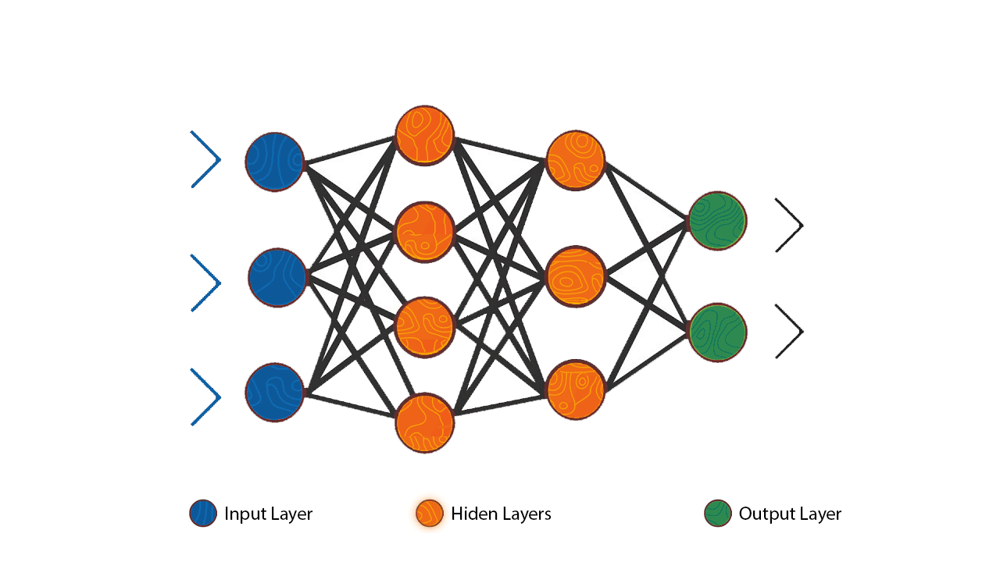
Multi-layer-perceptron
MLP is a type of feedforward neural network with fully connected layers and nonlinear activation functions.
It can solve problem where data is non linearly seperable.
It consists of an Input layer, one or more hidden layers, and output layer.
Forward Propagation: Data is passed through the layers to generate predictions.
Backpropagation: Weights and bias are adjusted to minimize errors and improve predictions.

